Slide 1
Bikera NETWORK
Eli Lievens

Slide 2

Vision
Create a blockchain ecosystem that will function as a means to lend or offer for rent; carbon neutral vehicles.
Connecting every smartphone holder with this decentralised system seamlessly through an intuitive mobile or web app.

Slide 3
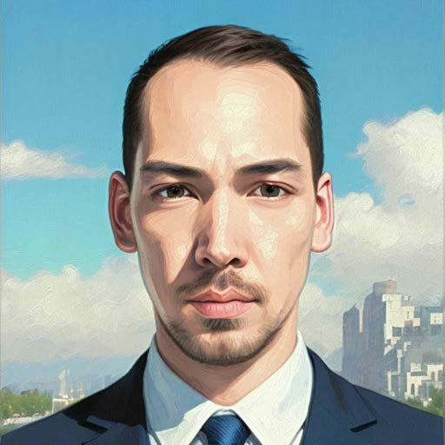
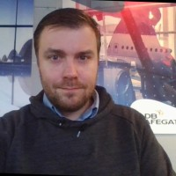

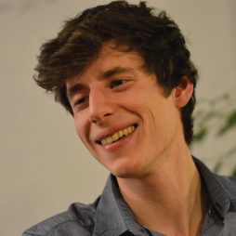
TITEL PRESENTATIE
Team
3
Kevin Blancaflor
Eli LIEVENS
Juan De Meester​​
Sam van de Perre
Chief Technical Officer
Chief Executive Officer​
Chief Financial Officer​
Engineer

Slide 4
ProblEms
Expensive rides
Most bike lending services are expensive and don't give back to their users,
This would add to a free market and supply infrastructure for new players
Maintenance
People who want to rent bikes without having the hassle of owning a bike. Fair public prices of bike repairs, maintenance and charging.

Slide 5




Service solutions
Digital support
Bikera gives individuals & companies with less technical knowledge capabilities to deliver a similar service as big coorporations
Alleen producten die specifiek voor deze nichemarkt zijn bedoeld
Semi Passive income
Anyone willing to add a bicycle to the network, is able to earn passive income for lending bikes and earning a piece of the mining rewards they genenerate
Ontworpen met de hulp en toewijding van experts in ht veld

Slide 6
Competition
Easy
DOT
BOLT
Expensive
Cheap
Donkey Republic
Blue Bike
Own Bike
Own electric bike
difficult

Slide 7





MoDEl
Investing
Userbase
Blockchain
DePIN
Proof of concept;
Running on Raspberry Pies, cloud infrastructure and Internet Computer
Expanding the network; growing userbase on different blockchains. Marketing efforts gamefied experience
Hqve mileage logged on blockchain verifyable. have NFT tokens earned as XP to validate efforts of using the networken
Designin IoT or integrating smart locks to enable a physical bicycle network connected to the blockchain

Slide 8
statistics
303
1,7K
19K
650K
Holders
Followers on X
Market cap
iMERA
Market Cap MERA
Inkomsten die zijn verkregen uit huur van onroerend goed
Bedrag verkregen via andere investeerders
Beschikbare liquide middelen
Aantal aandelen dat is geconverteerd naar USD

Slide 9
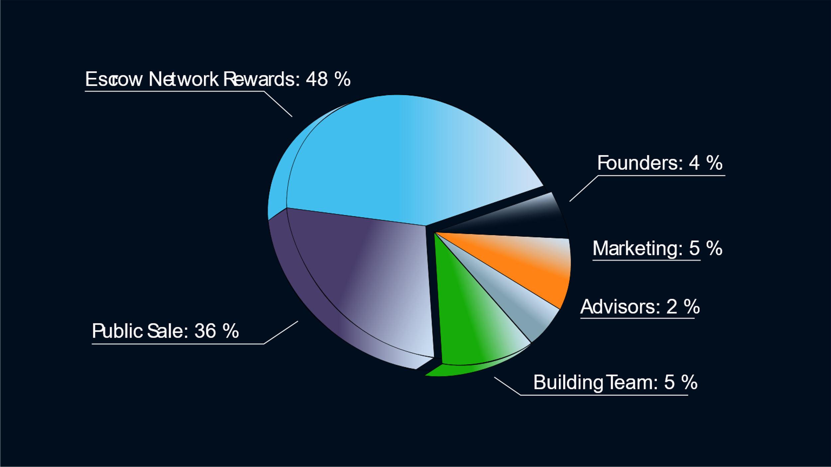

Token Distribution
9

Slide 10
Community EFfort
Bikers
Supporters
Validators
Val
Using transportation
Adding randomness to Proof-of-transit
Bounties for checking thieving attemps
Organize races
Offers transportation
Maintenance
Charging
Run nodes
Verify vehicles

Slide 11
Architecture
Data
Batched Data
Transactions and RPC calls
Mobile App
Cloud Database; Supabase
Solana
ICP
Canisters
Consenus immutability
BNB
Web app
Cloud Compute; cloudflare, replit
Ethereum/L2
Bike Lock
Wireless Gateway; Helium network, thingsix, Raspberry Pie
Avalanche
Integrated Bike

Slide 12
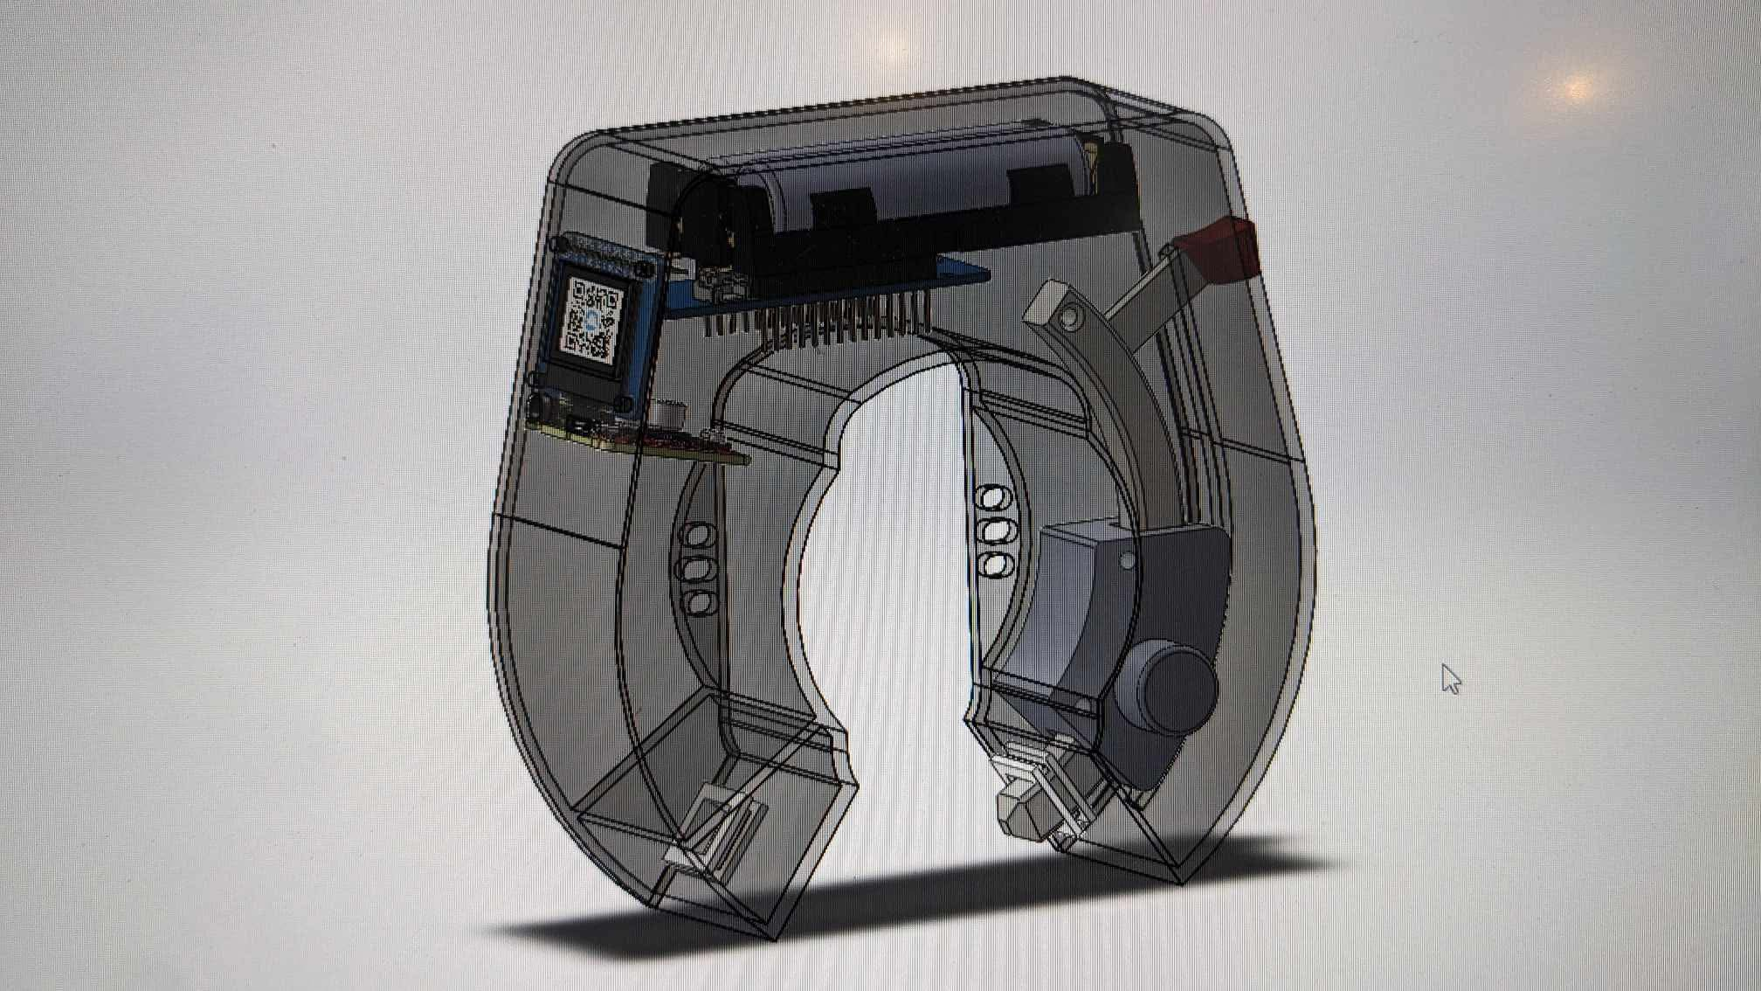
Prototype lock

Slide 13
Summary
Get out there and mine $iMERA ! Physical activity mining is the new bitcoin protocol,
Like ICP is the new cloud computing.

Slide 14
Thank you
Monica Krommenhoek​
206-555-0146​
monica@contoso.com
www.contoso.com​

